Slide 1
Big Data Technologies
Chapter 1
Introduction
To
Big Data
Instructor: Suresh Pokharel

Slide 2

Big Data Overview

Slide 3
Big Data Overview
A byte is a sequence of 8 bits (enough to represent one alphanumeric character) processed as a single unit of information. A single letter or character would use one byte of memory (8 bits), two characters would use two bytes (16 bits).
1024 byte = 1 Kilobyte (KB)
1024 KB = 1 Megabyte (MB)
1024 MB = 1 Gigabyte (GB)
1024 GB = 1 Terabyte (TB)
1024 TB = 1 Petabyte (PB)
1024 PB = 1 Exabyte (EB)
1024 EB = 1 Zettabyte (ZB)
1024 ZB = 1 Yottabyte (YB)
1 YB = 9,671,406,556,917,033,397,649,408 bits

Slide 4
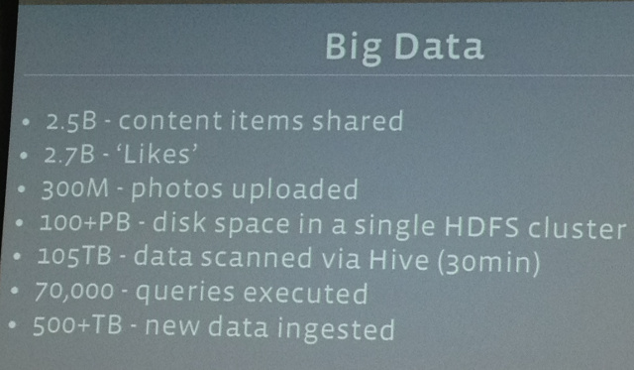
Data Produced: Facebook (each day)
Q3. Which is the most engaging social network?
Source = https://techcrunch.com

Slide 5
Data Produced: Twitter
Q3. Which is the most engaging social network?
100 million tweets per day
Twitter generates 8TB of data every day

Slide 6
Big Data Overview
According to Internet Live Stats, a website of the international Real Time Statistics Project, In One Second:
6,000 tweets are tweeted
40,000 Google queries are searched
more than 2 million emails are sent
According to Cisco's research,
8,000 petabytes per month of IP traffic was dedicated to video in 2015, compared with about 3,000 petabytes per month for Web, email and data transfer. (A petabyte is a million gigabytes or 2^50 bytes.)
All told, the company estimated that video accounted for most Internet traffic that year, at 34,000 petabytes.
File sharing came in second, at 14,000 petabytes.

Slide 7
Big Data Overview
The amount of data produced by us from the beginning of time till 2003 was 5 billion gigabytes.
The same amount was created in every two days in 2011, and in every ten minutes in 2013.
This rate is still growing enormously. Though all this information produced is meaningful and can be useful when processed, it is being neglected.
90% of the world’s data was generated in the last few years.

Slide 8
Introduction to Big Data - Definition
Big data : really a big data, it is a collection of large datasets that cannot be processed using traditional computing techniques (tutorial point )
Big data is a term for data sets that are so large or complex that traditional data processing applications are inadequate. Challenges include analysis, capture, search, sharing, storage, transfer, visualization, querying, updating and information privacy. ( wikipedia)

Slide 9
Introduction to Big Data - Definition
Big Data is a phrase used to mean a massive volume of both structured and unstructured data that is so large it is difficult to process using traditional database and software techniques. In most enterprise scenarios the volume of data is too big or it moves too fast or it exceeds current processing capacity.
Big Data has the potential to help companies improve operations and make faster, more intelligent decisions. This data, when captured, formatted, manipulated, stored, and analyzed can help a company to gain useful insight to increase revenues, get or retain customers, and improve operations
- webopedia

Slide 10
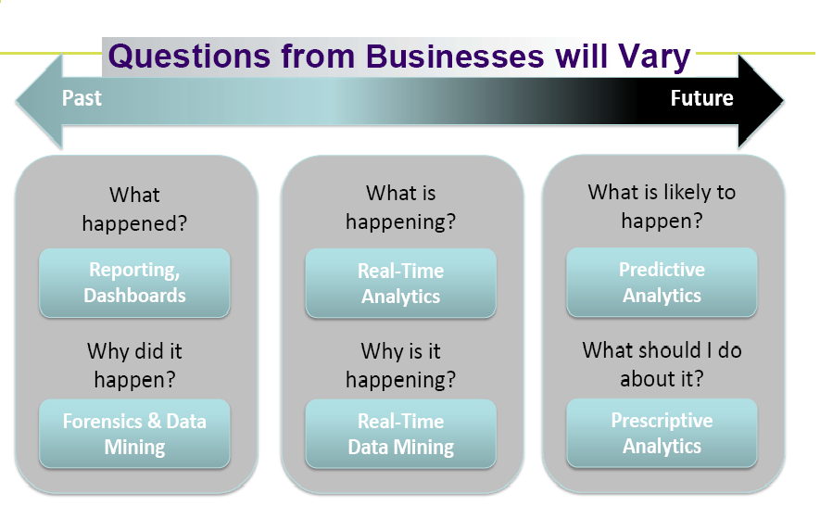
Introduction to Big Data

Slide 11
What Comes Under Big Data?
Black Box Data : It is a component of helicopter, airplanes, and jets, etc. It captures voices of the flight crew, recordings of microphones and earphones, and the performance information of the aircraft.
Social Media Data : Social media such as Facebook and Twitter hold information and the views posted by millions of people across the globe.
Stock Exchange Data : The stock exchange data holds information about the ‘buy’ and ‘sell’ decisions made on a share of different companies made by the customers.
Power Grid Data : The power grid data holds information consumed by a particular node with respect to a base station.
Transport Data : Transport data includes model, capacity, distance and availability of a vehicle.
Search Engine Data : Search engines retrieve lots of data from different databases.

Slide 12
What Comes Under Big Data?
Structured data : Relational data.
Semi Structured data : XML data.
Unstructured data : Word, PDF, Text, Media Logs

Slide 13
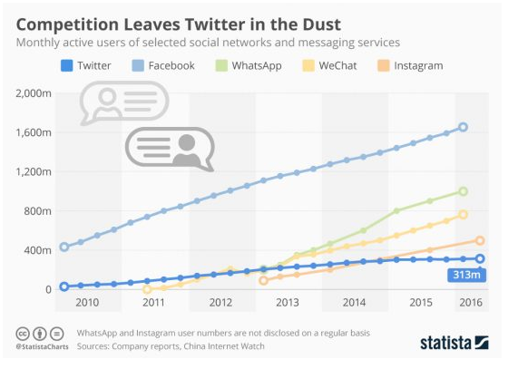
Data Produced
Q3. Which is the most engaging social network?

Slide 14
Big Data Overview
Big data has brought both great opportunity and change to the technological industry. Data Scientists traditionally look at the existing V's, the ones that have classically been unitized to understand key variables of any data set.
Volume
Velocity
Variety

Slide 15
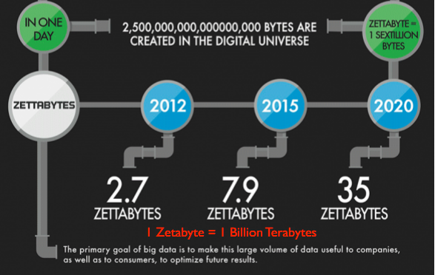
Big Data :Volume
Every mouse click, phone call, text message, web search, purchase transaction, and like on a social network is catalogued and stored in the cloud of big data.

Slide 16
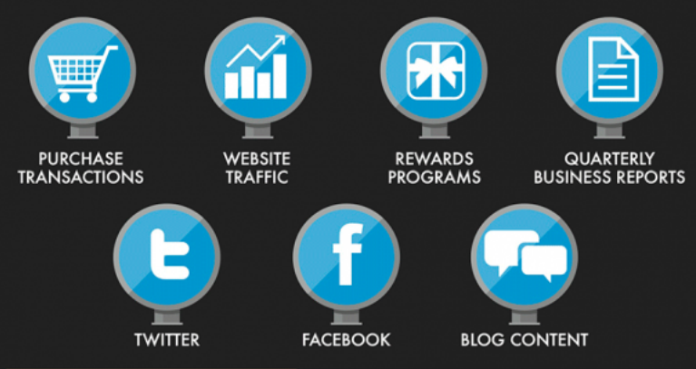
Big Data : Variety
In today's multi-faceted Internet culture, the great volume of data is also extremely varied in its form. So many variables can be thrown at a company that the true value of information can often be lost in the sea of data

Slide 17
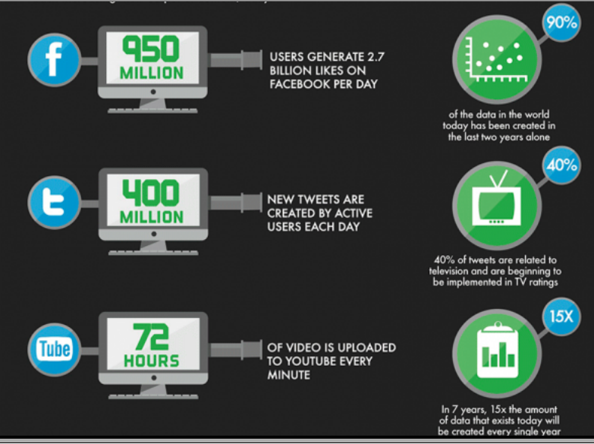
Big Data : Velocity
Information is being created at a faster pace than ever before. The varied channels of big data are each increasing their output of content, daily.

Slide 18
Big Data Challenges
Capturing data
Curation
Storage
Searching
Sharing
Transfer
Analysis
Presentation

Slide 19
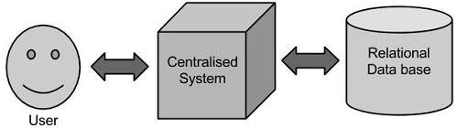
Traditional Approach
Limitation?????

Slide 20
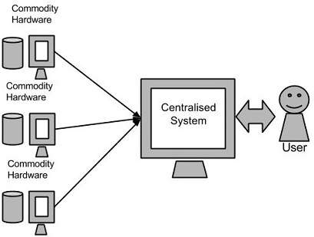
Big data: Google’s Solution

Slide 21
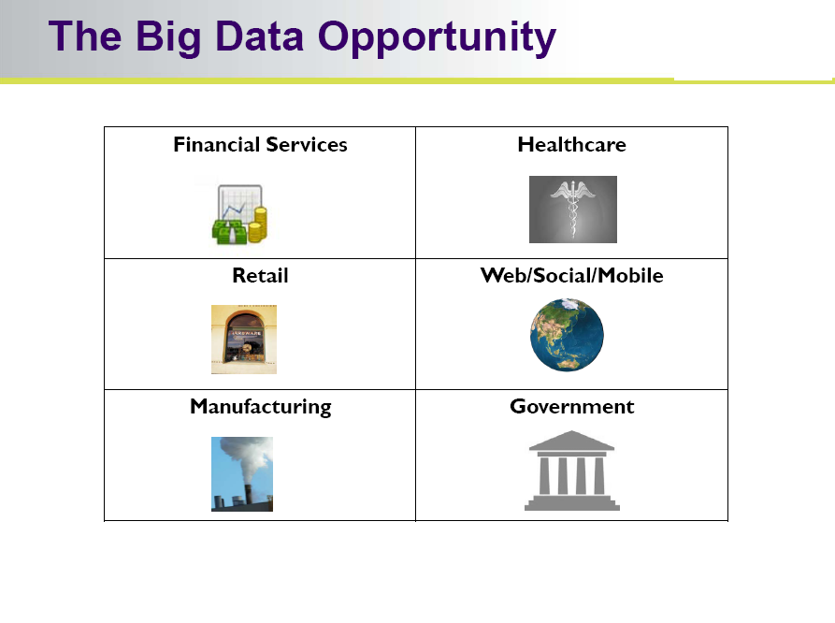
Big Data : Application

Slide 22
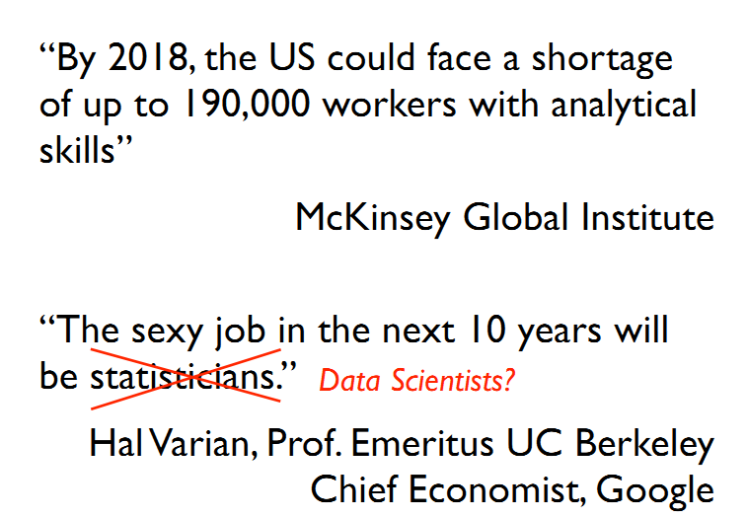
Big Data Overview

Slide 23
Background of Data Analytics
Big data has brought both great opportunity and change to the technological industry. Data Scientists traditionally look at the existing V's, the ones that have classically been unitized to understand key variables of any data set.
Volume
Velocity
Variety

Slide 24
Role of Distributed System in Big Data
Big data has brought both great opportunity and change to the technological industry. Data Scientists traditionally look at the existing V's, the ones that have classically been unitized to understand key variables of any data set.
Volume
Velocity
Variety

Slide 25
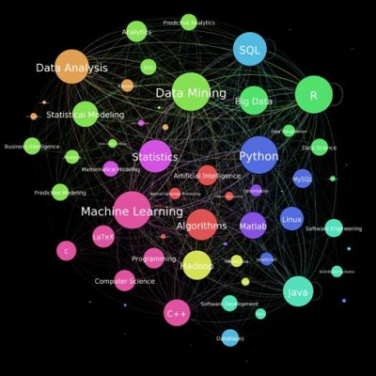
Role of Data Scientist
Figure : Focus area of Data Scientist

Slide 26
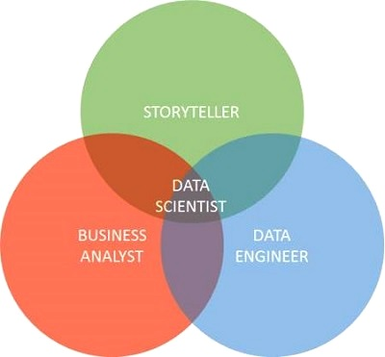
Role of Data Scientist
Figure : Data Scientist skill set

Slide 27
Data Analytics
Big data analytics can be done with the software tools commonly used as part of advanced analytics disciplines.
such as predictive analysis and data mining.
But the unstructured data sources used for big data analytics may not fit in traditional data warehouses.
Traditional data warehouses may not be able to handle the processing demands posed by big data.

Slide 28
Data Analytics
The technologies associated with big data analytics include NoSQL databases, Hadoop and MapReduce.
Known about these technologies form the core of an open source software framework that supports the processing of large data sets across clustered systems.
big data analytics initiatives include
internal data analytics skills
high cost of hiring experienced analytics professionals,
challenges in integrating Hadoop systems and data warehouses

Slide 29
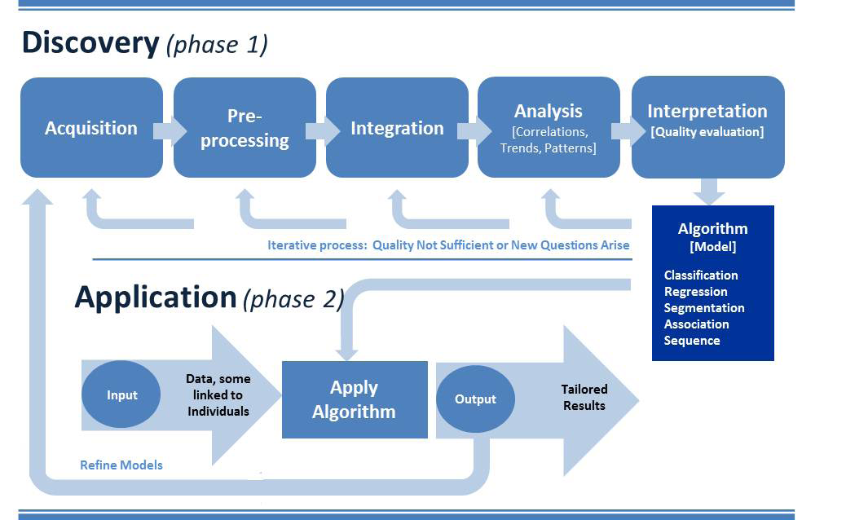
The Process of Analytics

Slide 30
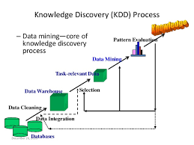
Data Analytics : KDD

Slide 31
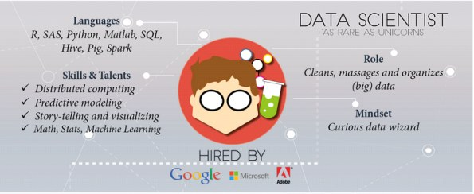
Role of Data Scientist

Slide 32
Data Scientist : Skill
Technical Skills
Programming: Python/ Java/other
Machine Learning and Data Mining
R/SAS/Matlab
Big Data
Hadoop
SQL
Mathematics: Statistics/Probability
Fundamentals of Software Engineering
Algorithms/Data Structure
Data Visualization
Non Technical Skills
Story Teller
Data enthusiastic
Business wisdom
Communication Skills
Analytic Problem-Solving
Self-Motivation

Slide 33
Role of Data Scientist (job)
Data Scientist Roles & Responsibilities: The Data Scientist will be responsible for designing and implementing processes and layouts for complex, large-scale data sets used for modeling, data mining, and research purposes. This individual is also responsible for business case development, planning, coordination/collaboration with various internal and vendor teams, project managing the lifecycle of an analysis project, and interface with business sponsors to provide periodic updates. The role will require working on multiple projects simultaneously.
Responsibilities:
Develop and plan required analytic projects in response to business needs.
In conjunction with data owners and department managers, contribute to the development of data models and protocols for mining production databases.
Develop new analytical methods and/or tools as required.
Contribute to data mining architectures, modeling standards, reporting, and data analysis methodologies.
Conduct research and make recommendations on data mining products, services, protocols, and standards in support of procurement and development efforts.
Work with application developers to extract data relevant for analysis.
Collaborate with unit managers, end users, development staff, and other stakeholders to integrate data mining results with existing systems.
Provide and apply quality assurance best practices for data mining/analysis services.
Adhere to change control and testing processes for modifications to analytical models.
Create data definitions for new database file/table development and/or changes to existing ones as needed for analysis.
Determine required network components to ensure data access, as well as data consistency and integrity.
Respond to and resolve data mining performance issues. Monitor data mining system performance and implement efficiency improvements.
Manage and/or provide guidance to junior members of the team.

Slide 34
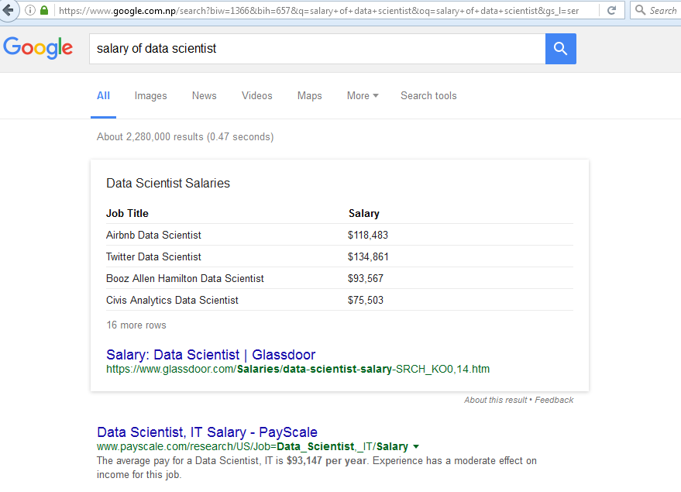
Data Scientist : Salary

Slide 35


